Slide 1
Mathematical epidemiology Short course
Day 4 : 7/25
Practical 8

Slide 2
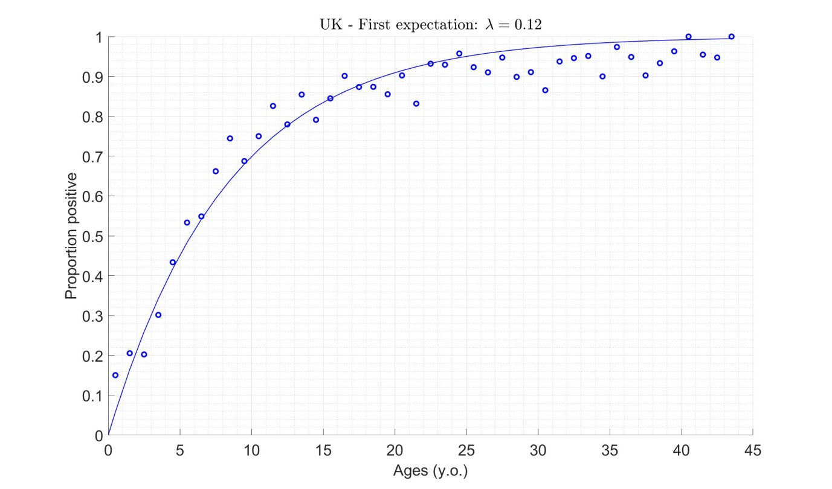
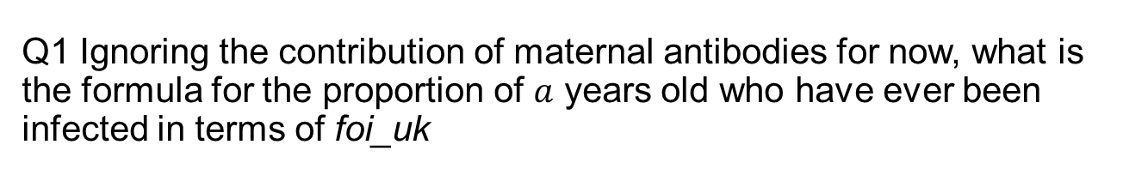
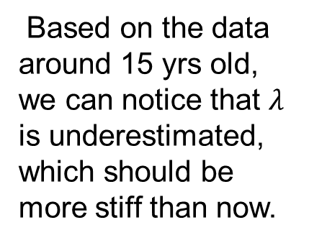
Q1 Ignoring the contribution of maternal antibodies for now, what is the formula for the proportion of $a$ years old who have ever been infected in terms of foi_uk
1-exp(-$λ_{UK}$a)
Q2 Do you think the true value for the force infection in the UK was greater or smaller than that currently assumed?
Based on the data around 15 yrs old, we can notice that $λ$ is underestimated, which should be more stiff than now.

Slide 3
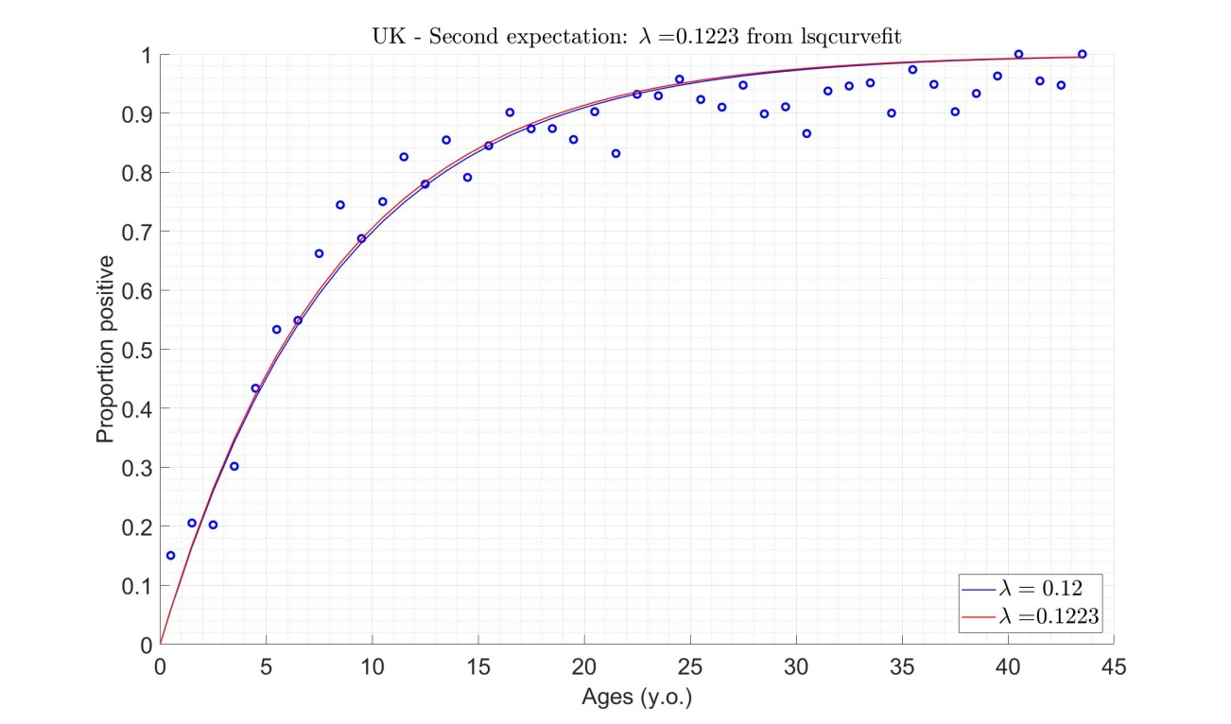
Q4 What is the best-fitting value for the force of infection? Is this consistent with your answer to question Q2 above?
With using lsqcurvefit method in Optimization Toolbox add-on, I got the λ as 0.1223.
It is slightly nicer than first expectation. However, there is still the basic problem which is underestimation of data.
Therefore, we can conclude the problem is not on optimization process.
Q5 For which age groups does the model underestimate the proportion of individuals who are sero-positive? For which age groups does it overestimate it?
Before the age 15, the values are underestimated, and after that, they are overestimated.

Slide 4

lsqcurvefit method
Ordinary Least Squares with fitting function
$∑{residual}^{2}=0.1086$
Tolerance = ${10}^{−6}$

Slide 5
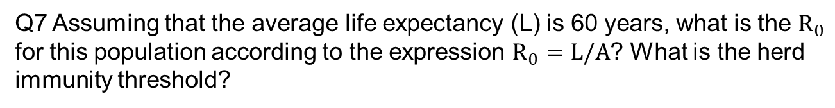


Q6 According to the formula you saw in the lecture, what is the average age at infection in the UK? (Assume that the force of infection is independent of age)
(Median) 5.6683 y.o.
$$A=\frac{1}{λ}=\frac{1}{0.1223}=8.1766 y.o.$$
Q7 Assuming that the average life expectancy (L) is 60 years, what is the $R_{0}$ for this population according to the expression $R_{0}=L/A$? What is the herd immunity threshold?
$$R_{0}=\frac{L}{A}=\frac{60 years}{8.1766 years}=7.3380$$
Herd Immunity $H=1−\frac{1}{R_{0}}=0.8637$

Slide 6
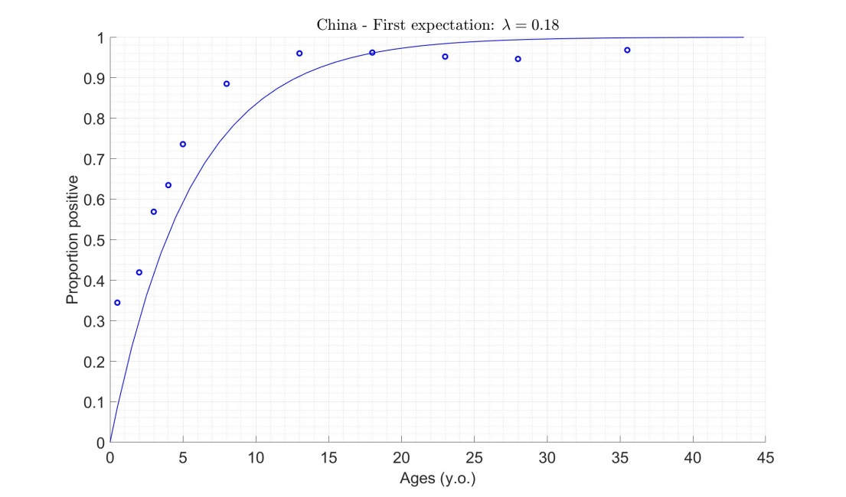
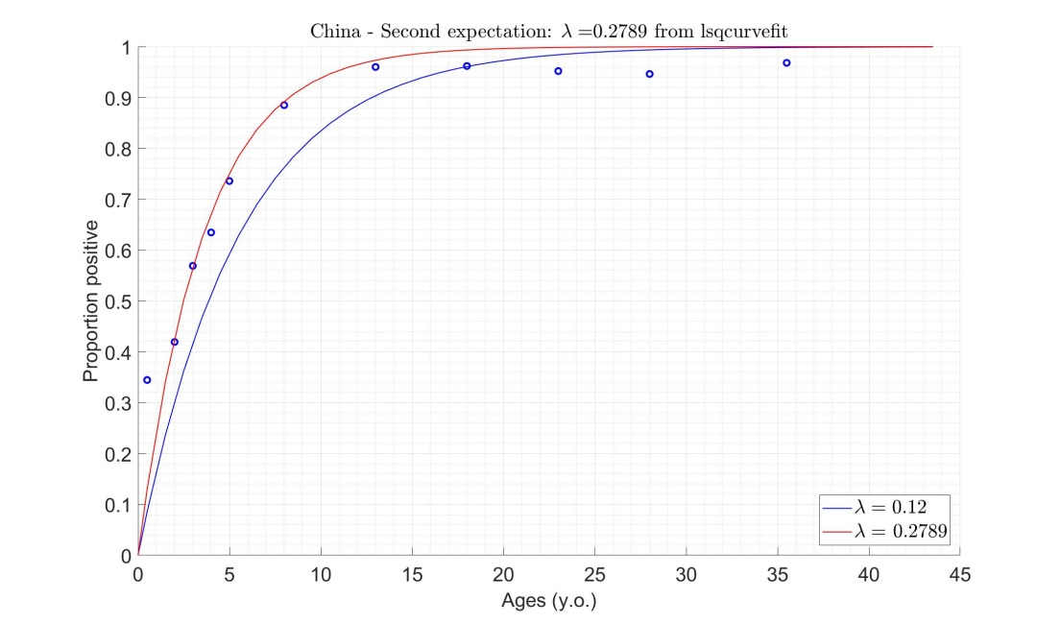
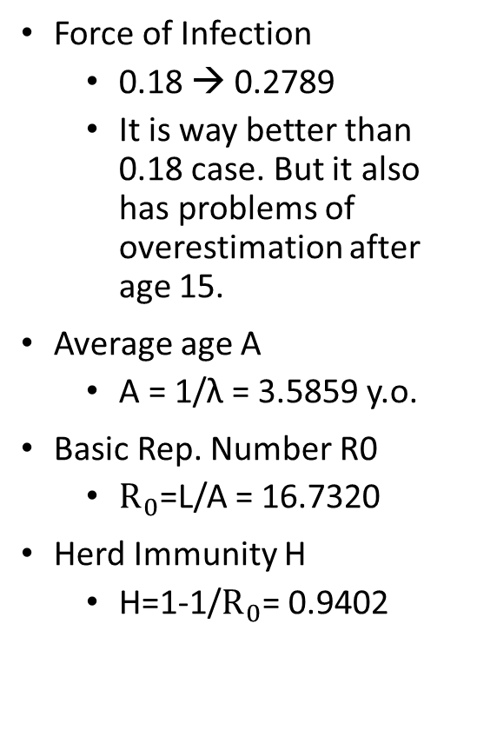
Q8 How do the values for the force of infection, average age at infection, R0 and herd immunity threshold in China compare against those for the UK? Suggest possible reasons for these differences.
Force of Infection
0.18 → 0.2789
It is way better than 0.18 case. But it also has problems of overestimation after age 15.
Average age A
A = 1/λ = 3.5859 y.o.
Basic Rep. Number R0
$R_{0}$=L/A = 16.7320
Herd Immunity H
H=1-1/$R_{0}$= 0.9402

Slide 7
Difference
To Data
Hygiene
The birth rate of China is way higher than UK.
The density of population is also.
From Data
The average age at infection of China is way younger than the one of UK.

Slide 8
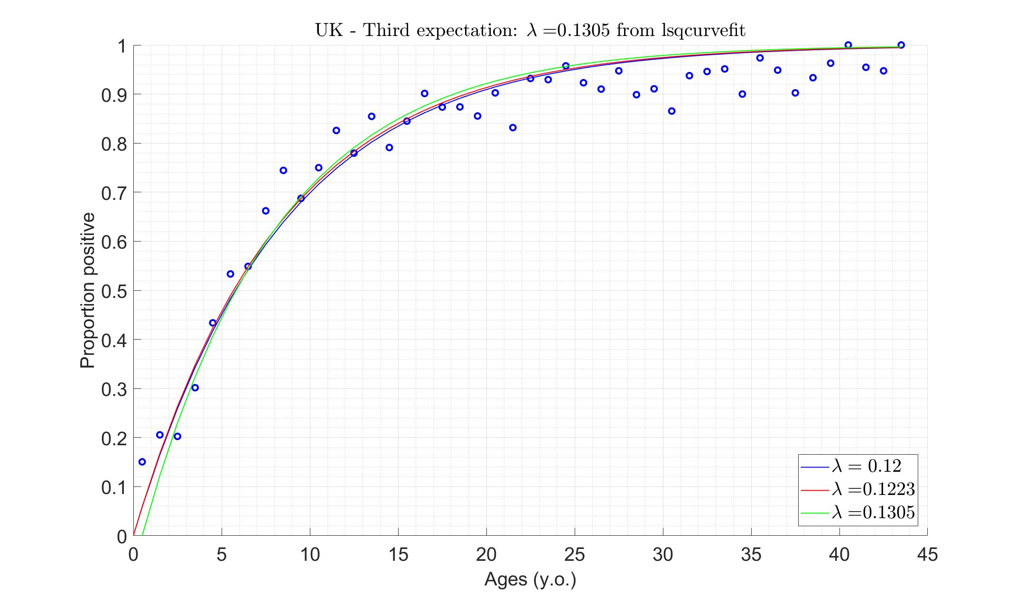
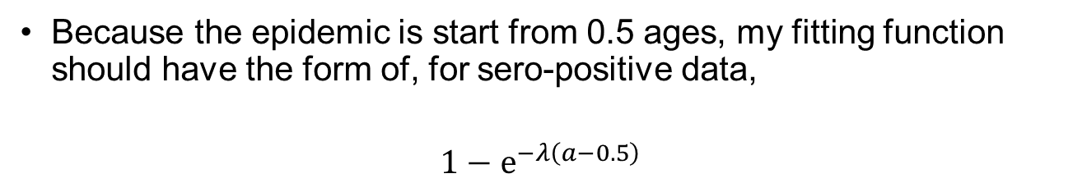
Q9 How should your estimate of the force of infection change if you were to assume that individuals are immune for the first 6 months of life as a result of maternal antibodies?
Because the epidemic is start from 0.5 ages, my fitting function should have the form of, for sero-positive data,
$$1−e^{−λ\left(a−0.5\right)}$$

Slide 9
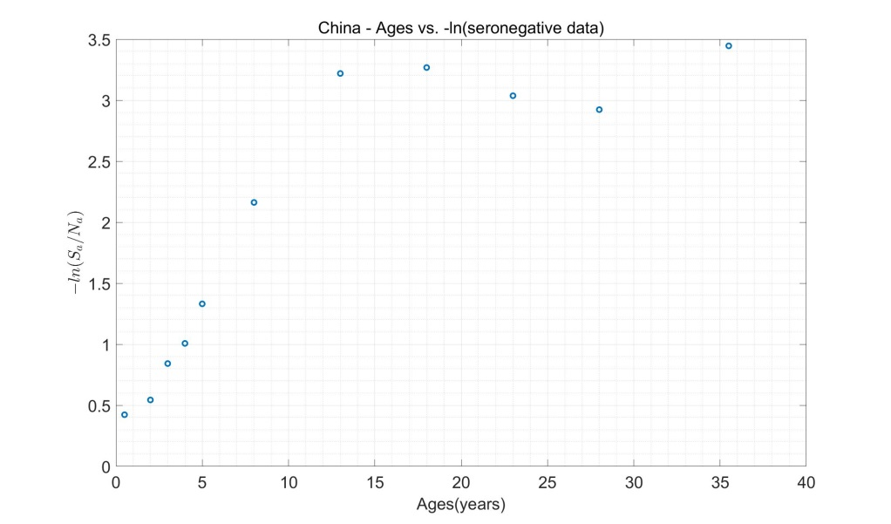
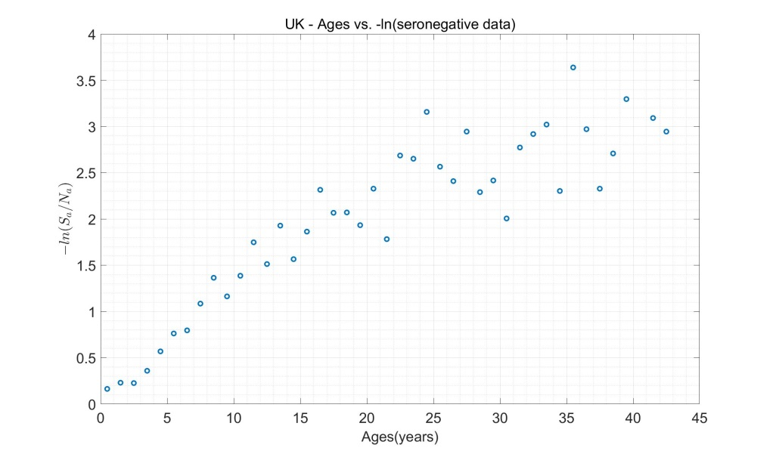
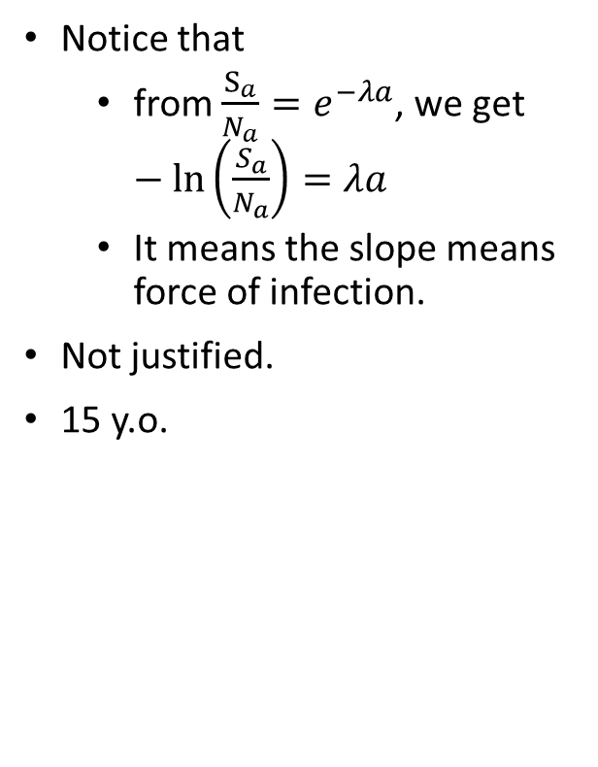
Q10 According to Figure 2 in the sheets for China and the UK, is the assumption that the force of infection is independent of age in these populations justified? At what age does it look as though the force of infection changes in these populations?
Notice that
from $\frac{S_{a}}{N_{a}}=e^{−λa}$, we get $−\ln\left(\frac{S_{a}}{N_{a}}\right)=λa$
It means the slope means force of infection.
Not justified.
15 y.o.

Slide 10
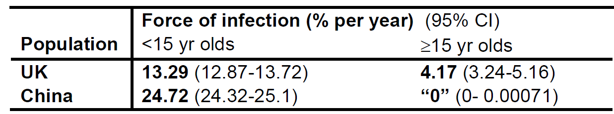
Q11 What do you notice about these values? Suggest reasons for the differences in the force of infection between China and the UK.
C.f) UK – 12.23%, 13.05% (Maternal) , China – 27.89%
Data balance (Each Seropositive Data)
UK – 2507 (<=15), 1665 (>15) – Diff: 842, Mult: 1.5057
China – 9304 (<=15), 7354 (>15) – Diff: 1950, Mult: 1.2652
Data resolution (Tendency)

